Slide 1


European Charter of Fundamental Rights

Slide 2

Your presenter
Tansu Osman, 27
Business graduate Entrepreneur
Law student

Slide 3
INTRODUCTION
One legal document for all of the most important human rights in the EU
Superior to domestic laws
6 Chapters
Since 07.12.2000

Slide 4

“THE RIGHTS OF EVERY MAN ARE DIMINISHED WHEN THE RIGHTS OF ONE MAN ARE THREATENED”
John F. Kennedy

Slide 5
OUR FUNDAMENTAL RIGHTS
1
2
3
DIGNITY
FREEDOMS
EQUALITY
4
5
6
SOLIDARITY
CITIZEN’S RIGHTS
JUSTICE

Slide 6
DIGNITY AND FREEDOMS
DIGNITY
FREEDOMS
RIGHT TO LIFE, DIGNITY, INTEGRITY
NO DEATH PENALTY
NO SLAVERY AND FORCED LABOUR
RESPECT FOR PRIVATE LIFE
PROTECTION OF PERSONAL DATA
FREEDOM OF EXPRESSION AND INFORMATION

Slide 7
EQUALITY AND SOLIDARITY
EQUALITY
SOLIDARITY
EQUALITY BEFORE THE LAW
NO DISCRIMINATION
FAIR WORKING CONDITIONS
HEALTH CARE
CONSUMER PROTECTION

Slide 8
CITIZEN’S RIGHTS AND JUSTICE
CITIZEN’S RIGHTS
JUSTICE
THE RIGHT TO HAVE A SAY IN ANY DECISION THAT WOULD HAVE AN EFFECT ON YOU
RIGHT TO HAVE A FAIR TRIAL
PRESUMPTION OF INNOCENCE
RIGHT TO LEGAL AID AND DEFENCE

Slide 9
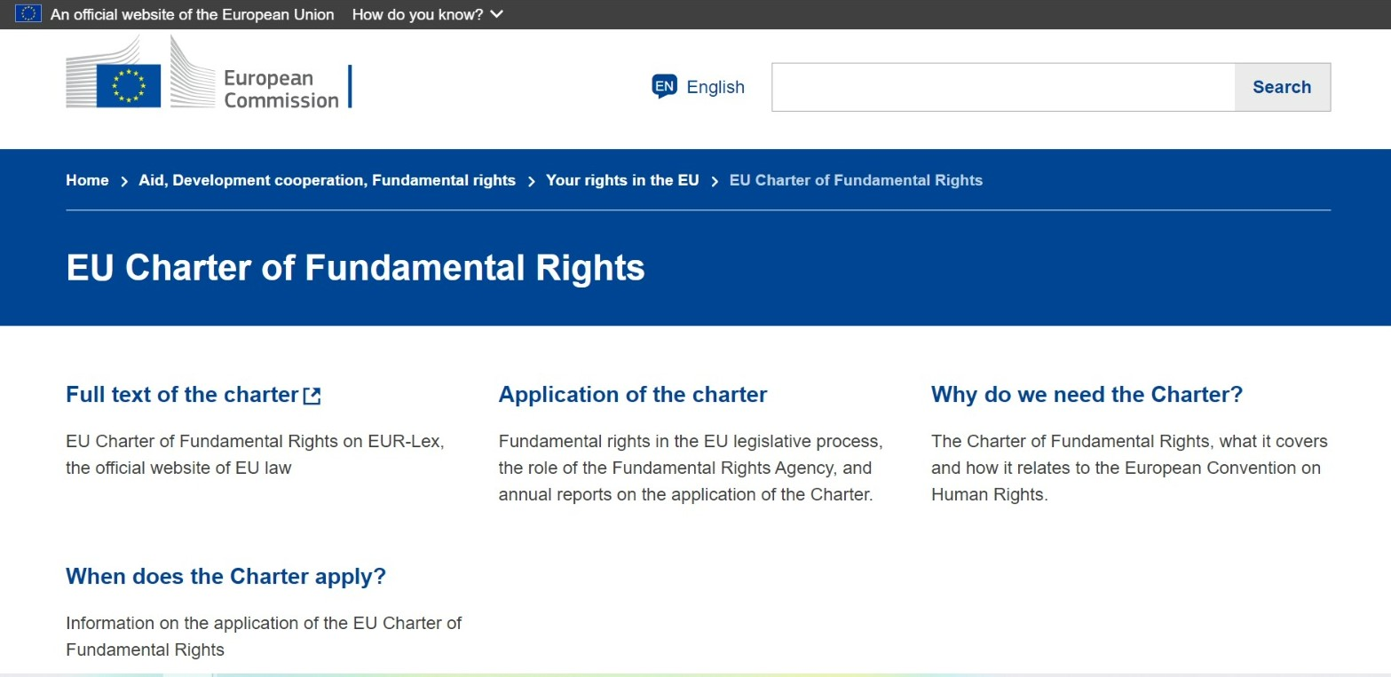

MORE INFO

Slide 10
—MALALA YOUSAFZAI
“
“Let us remember: one book, one pen, one child and one teacher can change the world”

Slide 11
You comment under a picture of a stranger on Instagram: “You’re so ugly”
?
?
They deny your college application because of your ethnicity
Your boss says that you have to work at least 10 hours a day without breaks
?

Slide 12
THANKS!
Do you have any questions?

