Slide 1
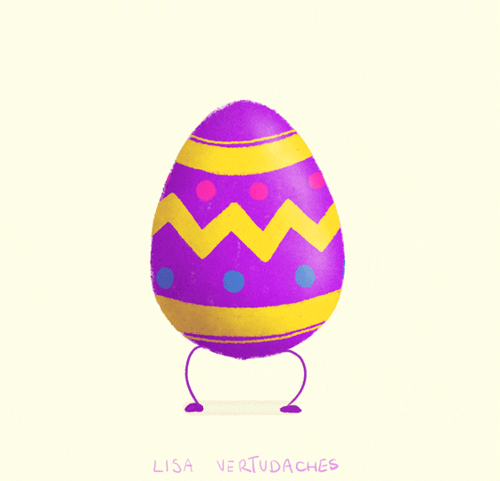
Easter
Made from: Alekzandar, Billiyana, Gabriela, Daniel, Malvina and Mikaela

Slide 2
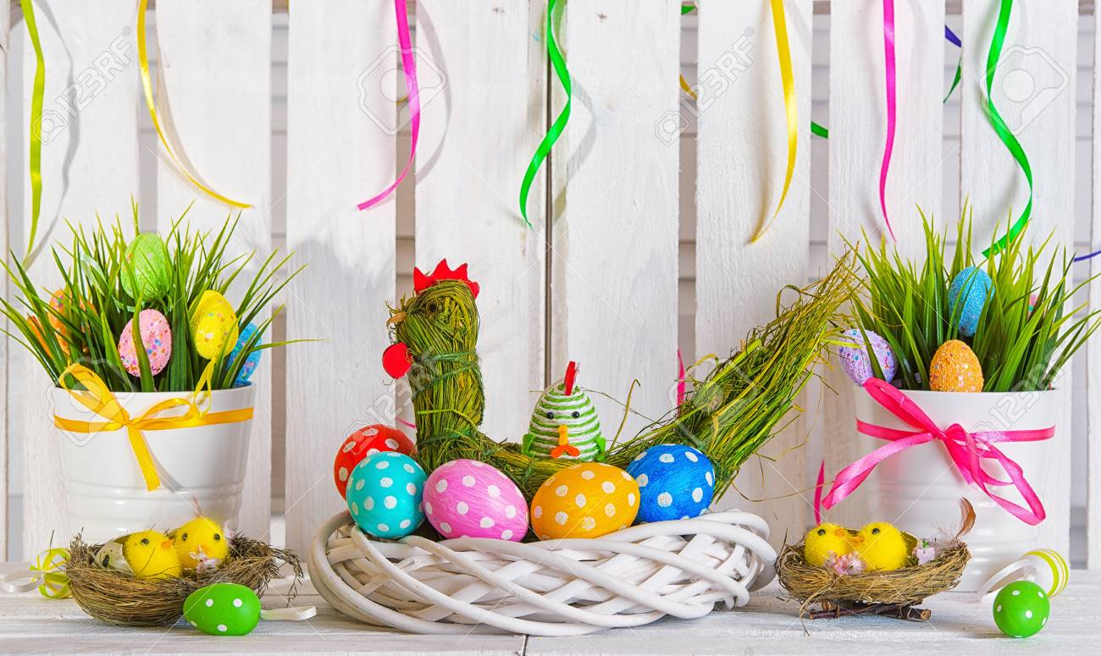
  Easter is a holiday, that is celebrated all over the world. But do you know how we celebrated it in Bulgaria?Now you will learn!

Slide 3
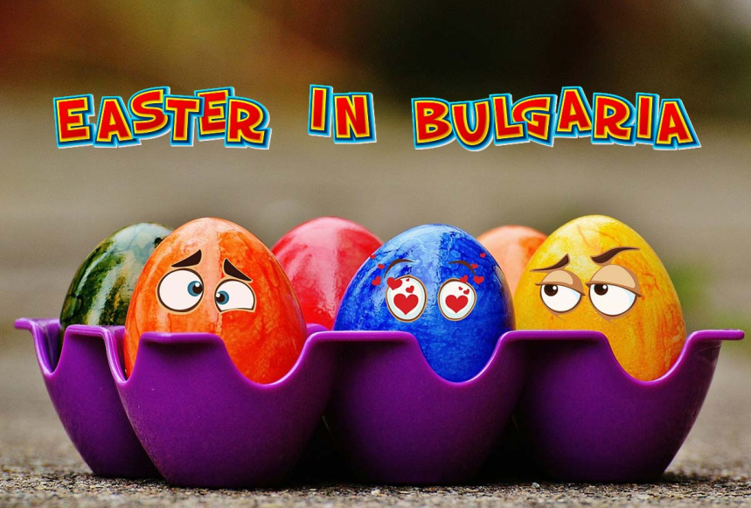
How do we celebrate Easter?
As you may know, Bulgarians are Orthodox Christians, and Easter here differs than in the catholic countries. If you are on the territory of Bulgaria during our Easter, get ready for a great celebration.

Slide 4
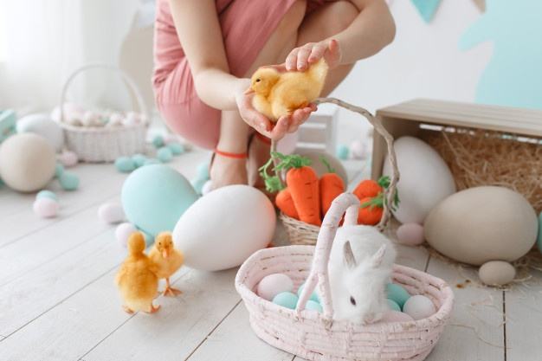
When is Easter celebrated?
The day depends on the moon calendar, which is different from the sun calendar, so this is the main reason for the changes in the dates. This year Easter is on 19th April.

Slide 5
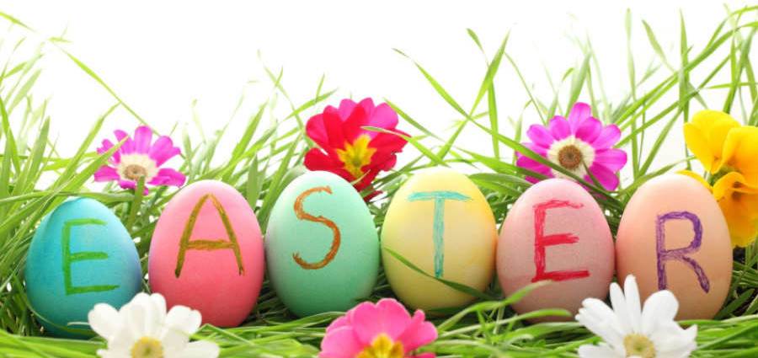
The week of Easter
The week before Easter is called the Passion week. This week is dedicated to the preparation for the great day. The most important days are Wednesday, Thursday, Friday and Saturday.

Slide 6
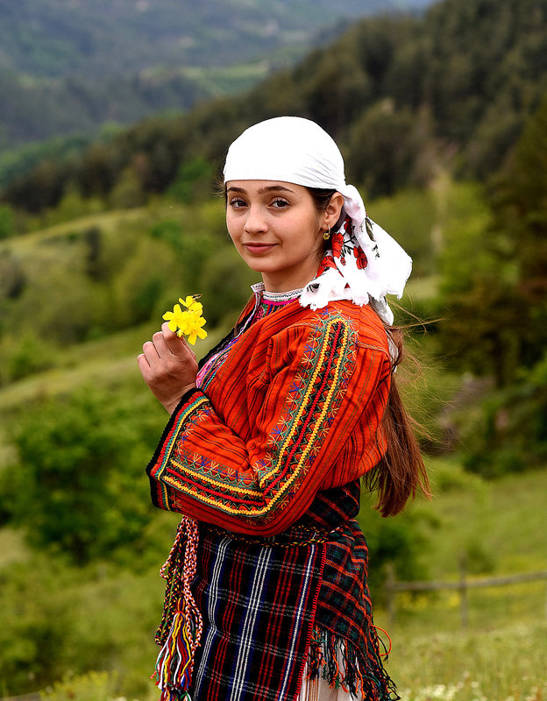
The great Wednesday
On the great Wednesday the women mustn`t work. In the evening in the villages of Rhodopes and Strandja people pick herbs and grass, nettle and geranium, which they tie in bouquets. On the next day they bring these bouquets to their relatives and neighbors.

Slide 7
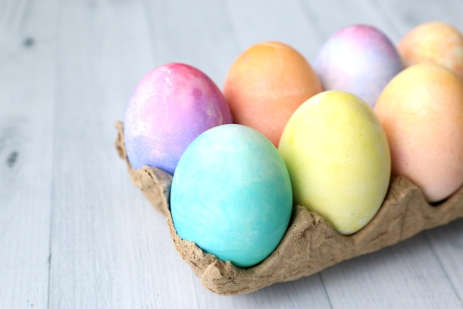
The Great Thursday
On the great Thursday are painting eggs. They eat up to the Savior, that is 40 days. From them is given to relatives, to the poor and everyone who enters the house during the Light Sunday to the week before Easter. For this the hosts prepared a full bucket with painted eggs. Another important work on Holy Thursday is the preparation of Easter bread. They are prepared with fat and have different shapes and names. They are decorated with an odd number of white and red eggs arranged like a cross. Holy Thursday is celebrated to protect against hail. Women should not wash, spin or sew, and men should not plow.

Slide 8
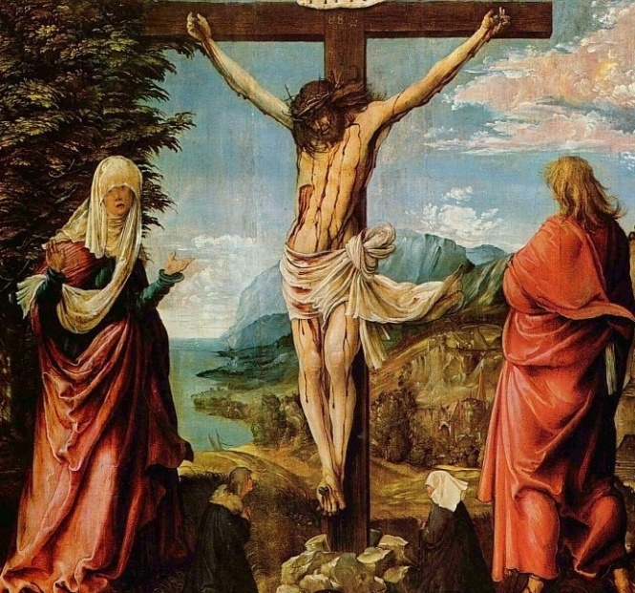
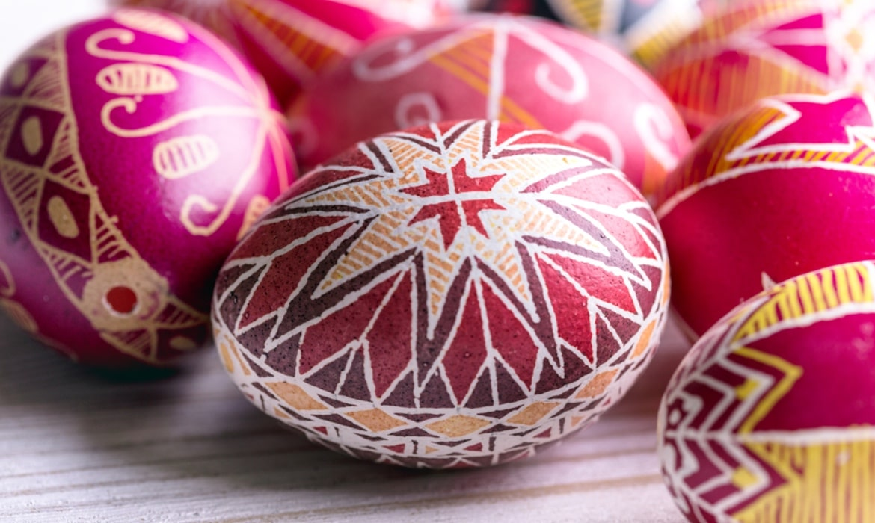
The Great Friday
Good Friday is the day on which the Son of God, Jesus Christ, was crucified as a sacrifice for the sins of the people. On this day, nothing is eaten or drunk, not even water. Tradition dictates that the newlyweds visit their parents, godparents and brother-in-law, bringing them a bow, a canister - a basket of painted eggs. The hosts also give them eggs. Everyone is sitting around a rich table. When the feast is over, swings are tied to the branches of tall trees and girls, women and children swing to protect themselves from bad diseases.

Slide 9
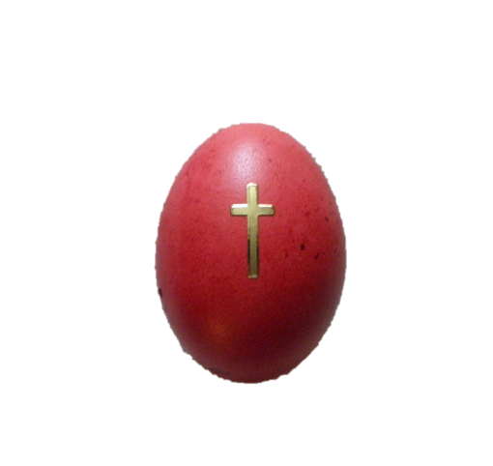
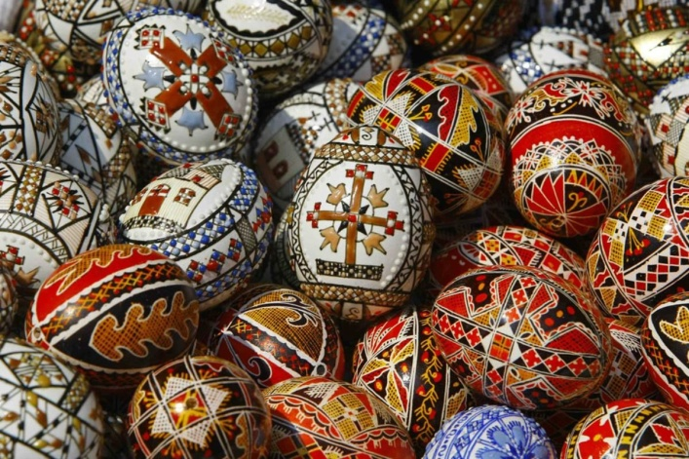
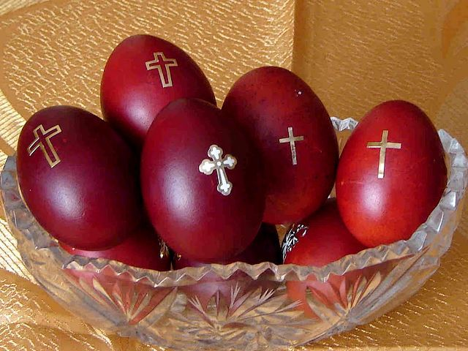
The first painting of eggs
It was a custom in the Jews, when they go to guest, to bring as gift for the host an egg. An Christian legend tell us when Maria Magdalina goes to Roma to see the Roman emperor, she bring an red egg for him, a symbol of the blood of Christ. Perhaps since Easter, Christians have been observing the custom of donating red eggs.

Slide 10
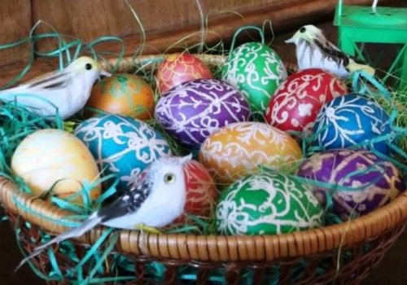
How we paint eggs?
Before the eggs were painted, the women carefully cleaned them with ash-water and ash. The first egg is always red. It is rubbed on the children's faces and a cross is drawn on their foreheads so that they are always red and healthy. The egg is placed under the house icon and kept until Holy Thursday of the following year. Then it breaks and inside it foretells the future of the house and the family.

Slide 11
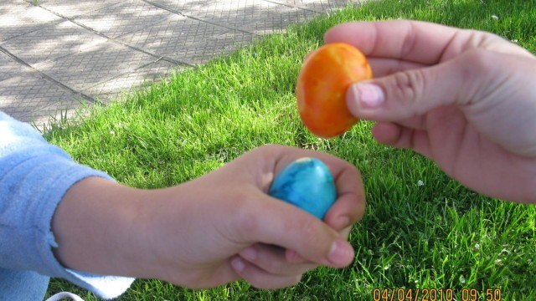

Easter- The great day
Easter is celebrated for three days. Sunday is the Resurrection of Christ and all the festivities changed go to church. The lighted candle goes home. And everyone congratulates with “Christ is Risen”, and the answer is “Truly Risen”. We are fighting with eggs and the person with the strongest egg will be healthy all year.

Slide 12
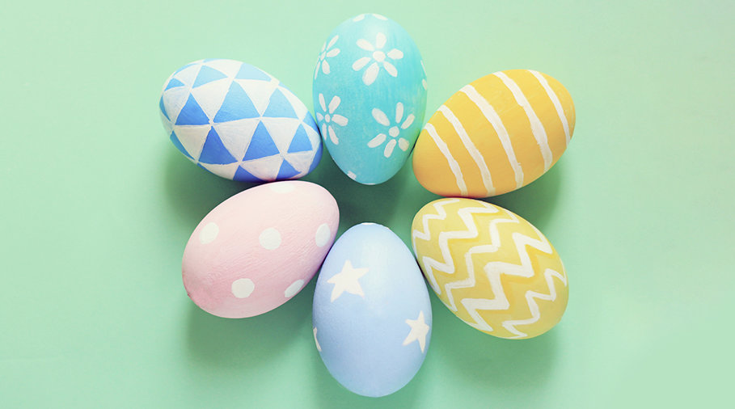
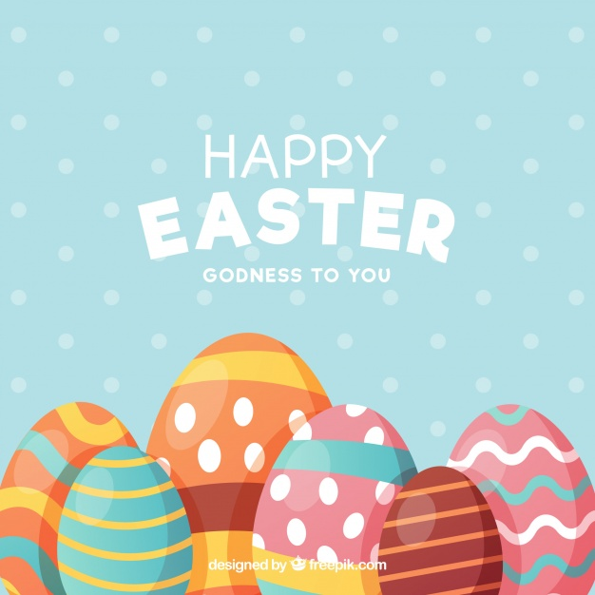
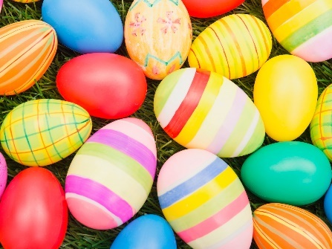
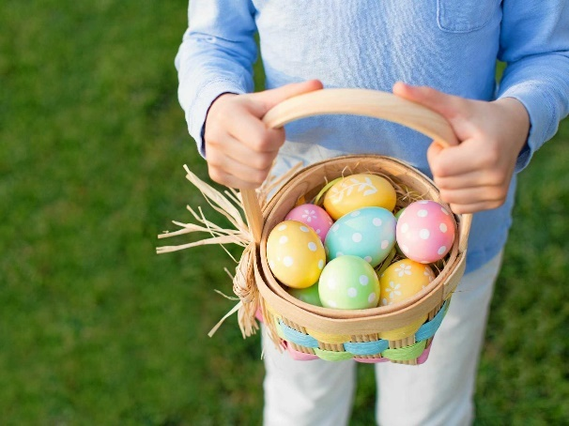
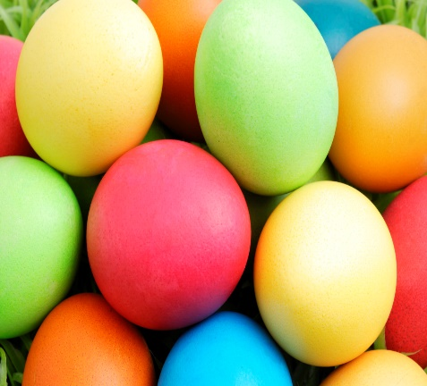

Slide 13
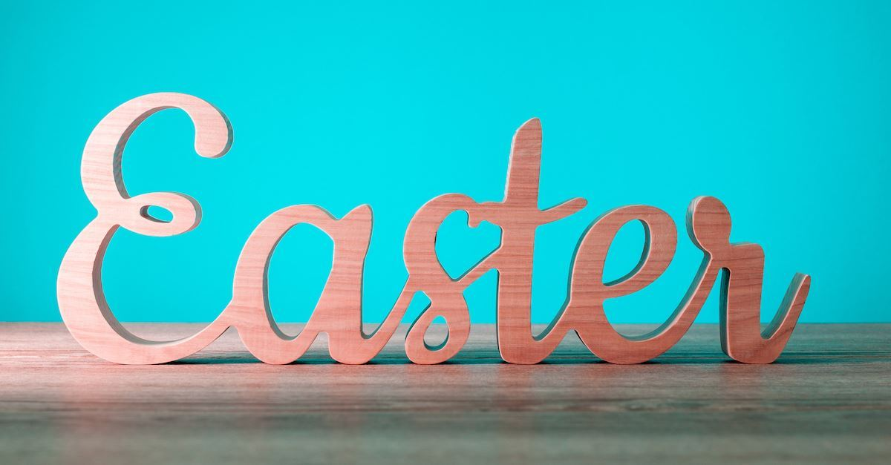
Thanks for watching!

