Slide 1
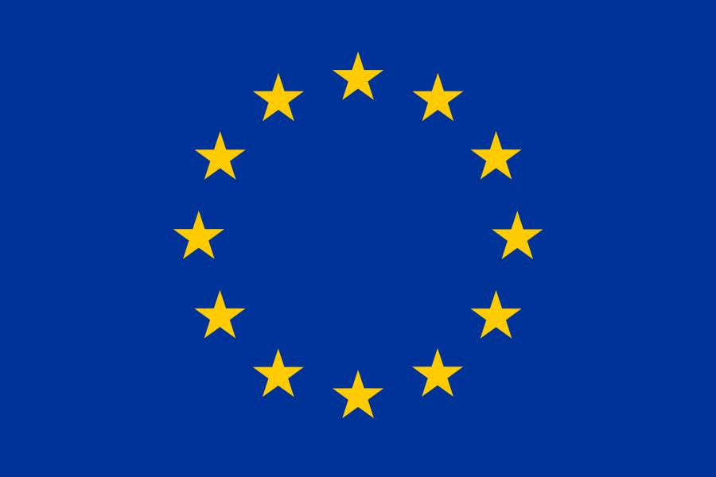
9 May - Europe Day
Prepared by: Magdalena Filcheva 6d

Slide 2
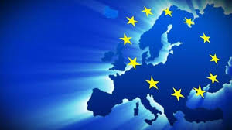
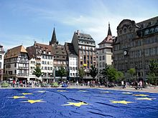

Europe Day is dedicated to peace and unification in Europe.
May 9, in addition to being Europe Day, is also known as Schuman Day, commemorating the Schuman Declaration of French Minister Robert Schuman.

Slide 3
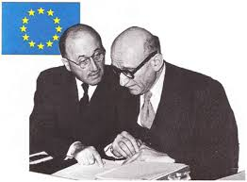
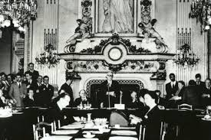
In his speech on 9 May 1950 in Paris, Robert Schumann (French Foreign Minister at the time) shared his idea of ​​a new form of political cooperation in Europe that would make war between the peoples of Europe impossible.

Slide 4
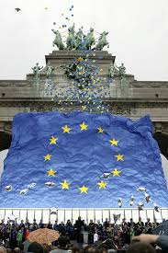
His idea was to create a European institution to unite and manage the production of French and West German coal and steel.
Only a year later, the contract for the establishment of such an institution was signed. Schuman's proposal is considered the beginning of what we now call the European Union.

Slide 5
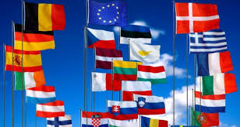
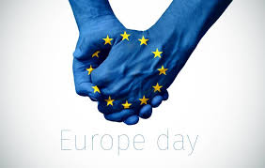
European Union Day celebrates the day on which the creation of the EU's precursor - the European Coal and Steel Community - was proposed in 1950.
Europe Day is one of the European symbols that promote unity among Europeans.

Slide 6

In 1985, the Heads of State of the European Union, at their meeting in Milan, decided to celebrate May 9 as Europe Day. From then until today, May 9 symbolizes the pursuit of unity, peace and prosperity in Europe.
This date became a symbol of a united Europe along with the blue flag with golden stars, the Ode to the Joy of Beethoven's Ninth Symphony written by Friedrich Schiller and the single currency (the euro).

Slide 7
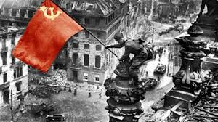
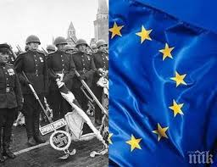
May 9 coincides with the eve of Germany's invasion of the Netherlands, Belgium and France.
May 9 also coincides with Victory Day, the end of World War II in Europe, celebrated in the former Soviet Union and the Russian Federation.
On May 9, 1945, the Wehrmacht Chief of Staff, Field Marshal Kaitel, signed the German surrender with the USSR..

Slide 8
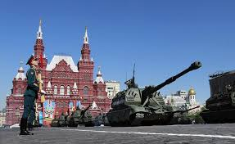
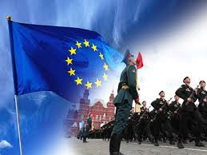
In Western Europe, the day of victory over fascism is celebrated on 8 May.
The reason for the difference in date is the difference in time of day - late on the evening of May 8, Winston Churchill and Harry Truman declare the end of the war in Europe (early hours of May 9, Moscow time).

Slide 9
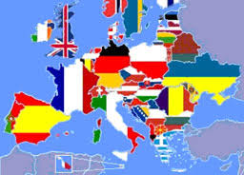
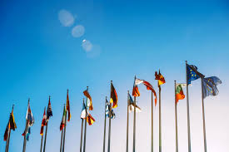
May 9 is celebrated in various forms in most EU member states and EU candidate countries, such as Turkey. Europe Day is an occasion for festive events in many European countries.
This is another way for people from different nations to feel united Europeans.
Due to the political nature of this day, it is used as an opportunity to inform people about the EU and to speak in support of European integration.

Slide 10
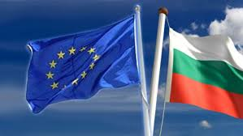
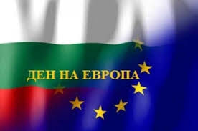
In Bulgaria, it was proclaimed by Council of Ministers Decree 54 of March 29, 2005 to mark May 9 - Europe Day.
In this way, two significant moments in the history of the continent are united in the hearts of the people - the victory over fascism, born in united efforts and deeply suffered, and the pursuit of prosperity and peace.

Slide 11
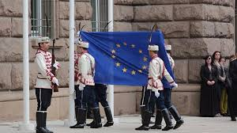
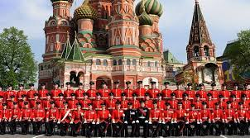
Each country that has democratically joined the European Union upholds its core values ​​- peace and solidarity.

Slide 12
THANK YOU FOR YOUR ATTENTION!

