Slide 1



Slide 2
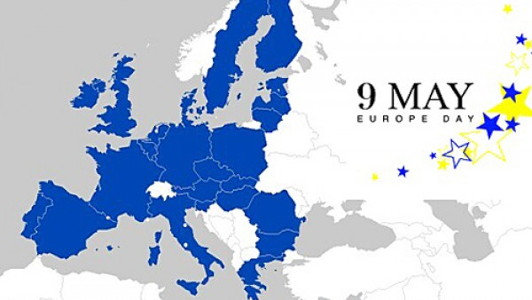
For what is it about?
Europe Day held on 9 May every year celebrates peace and unity in Europe. The date marks the anniversary of the historical 'Schuman declaration'. At a speech in Paris in 1950, Robert Schuman, the then French foreign minister, set out his idea for a new form of political cooperation in Europe, which would make war between Europe's nations unthinkable.

Slide 3

My message
Let all people in the world live in peace ,understanding and harmony. Be grateful of what they have and keep the world save.
No more wars!

