Slide 1
Europe Day
Prepared: Eleonora Marinova from 7d klas

Slide 2
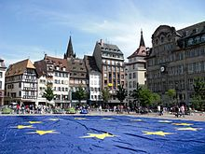
Europe Day is dedicated to peace and unification in Europe. There are two separate days listed for Europe: May 5 for the Council of Europe and May 9 for the European Union. The second is also known as Schumann Day, commemorating French Minister Robert Schuman's Schuman Declaration.

Slide 3
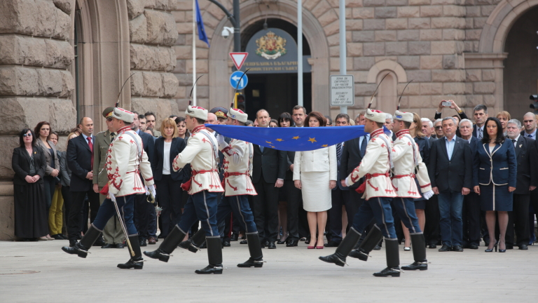
We are celebrating Europe Day and Victory Day
May 9th is celebrated as Europe and NATO Day of Europe, but also as Russia's Victory Day. It has been 74 years since the end of World War II and 66 years since the Robert Schuman Declaration.

Slide 4
In 1950, five years after the end of World War II, European countries were still trying to overcome their defeat.
All European countries celebrate May 9 as Europe Day. They reunited after World War II. United and united against different challenges. One of them is the Corona virus. The effort of the whole European Union is to defeat it. The unity makes us stronger and more secure.

Slide 5
Thank you for your attention ☺

